Slide 1
Environmental Linked Features IE Outcomes
109th OGC Technical Committee
Charlotte, NC USA
David Blodgett
11 December 2018 See html version of this presentation here.

Slide 2
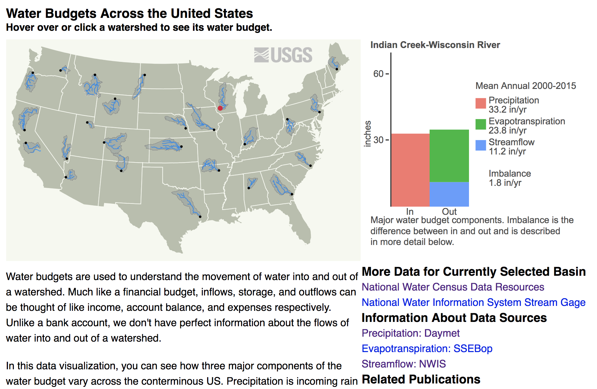
ELFIE Was Use Case Driven
Demo materials available here.

Slide 3
Goals
Increase interoperability while decreasing data duplication and maintenance overhead
Combine the power of web services with transparency of linked data
Encode relationships between and among environmental features
Encode highly general “preview” content for any feature
Utilize commonly used and easily adopted approaches

Slide 4
Defining the problem...
Current OGC services, while flexible and capable, do not directly allow exposure of features in a REST-ful way or provide traversable hypermedia describing available methods, data, or interfaces to related (linked) content.

Slide 5
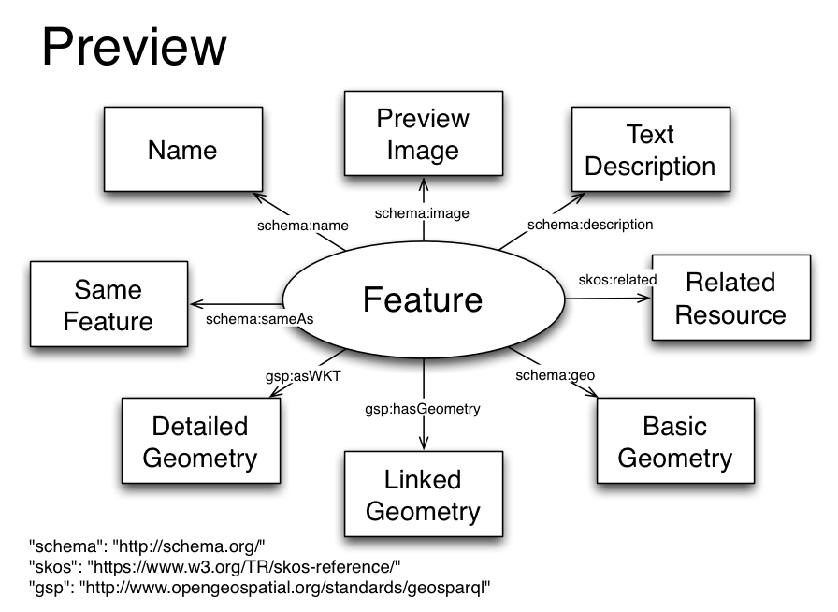
Preview

Slide 6
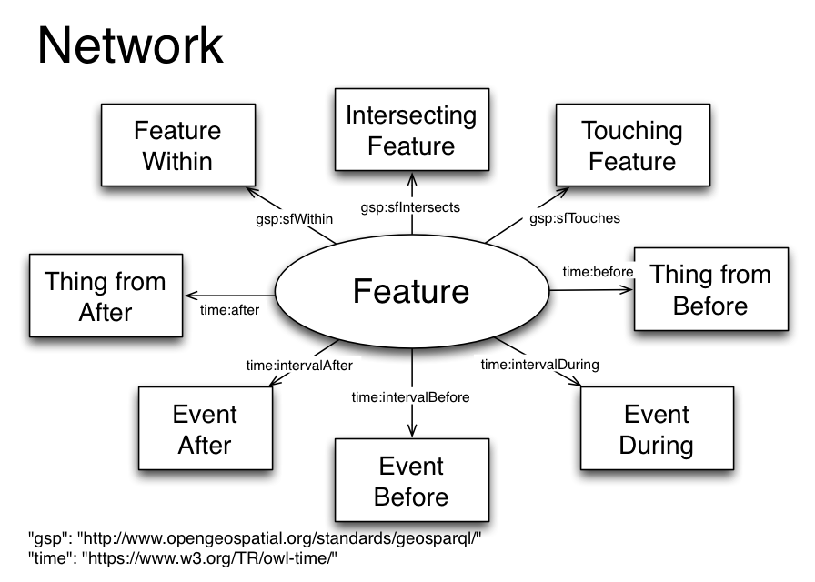

Slide 7
Monitoring and domain models...
Sensors, Observations, Samples and Actuators (SOSA)
Timeseries Markup Language (TimeseriesML)
Surface Hydrology Features (HY_Features)
Growndwater Markup Language 2 (GWML2)
Geoscience Markup Language 4 (GeoSciML)
Soil Data Interoperability Experiment (SoilIEML)
Floodcast (Experimental)

Slide 8
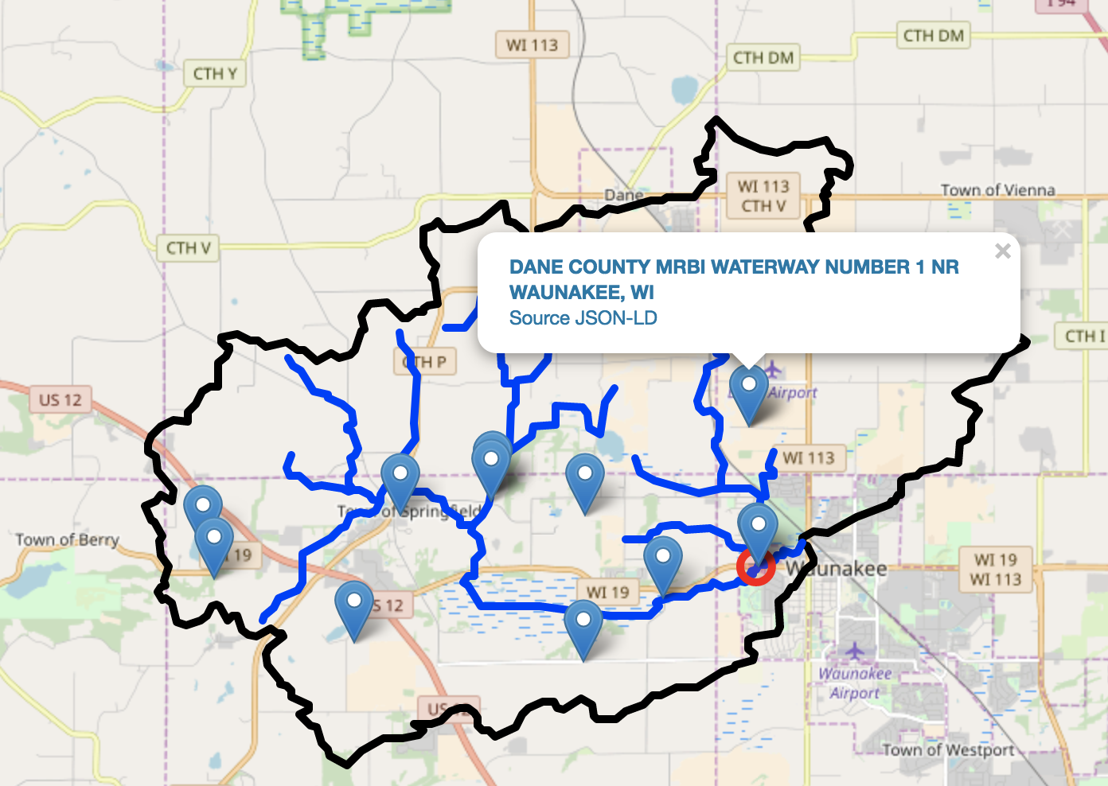
Use Cases: Watershed Data Index

Slide 9
Use Cases: US Water Budgets

Slide 10
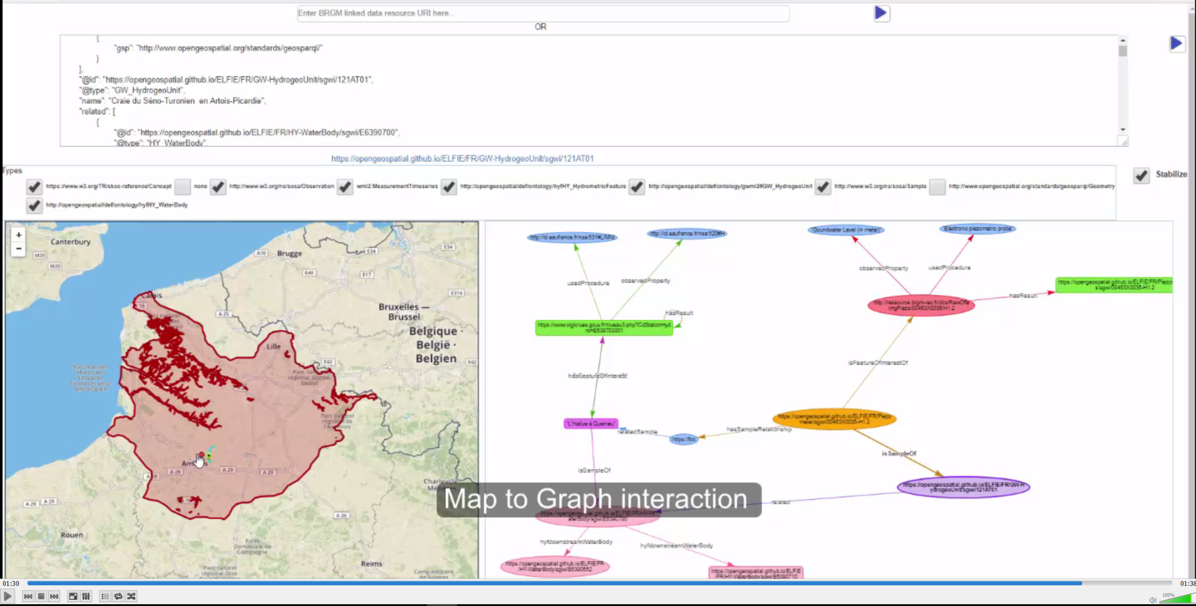
Use Cases: Surface-Ground Water Networks Interaction

Slide 11
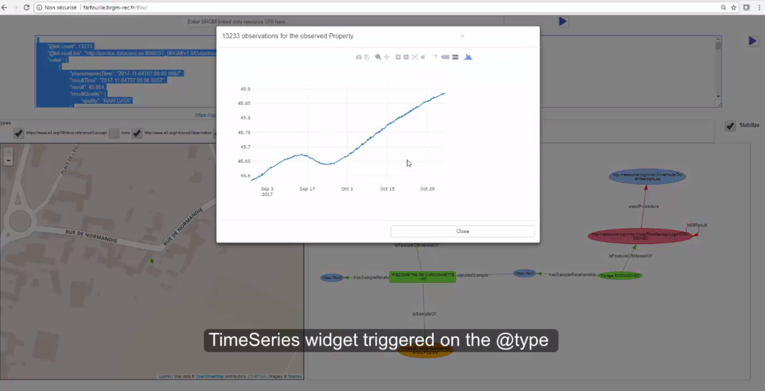
Use Cases: Ground Water Monitoring

Slide 12
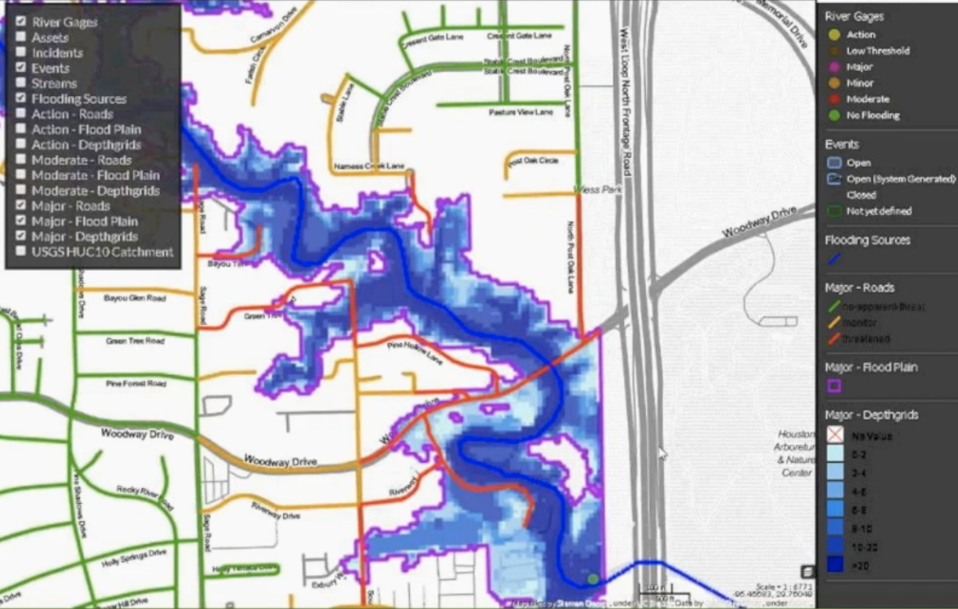
Use Cases: FloodCast

Slide 13
Outcomes
Engineering Report to be Presented to OGC https://portal.opengeospatial.org/files/?artifact_id=81777&version=1
Web summary of use cases available now. https://opengeospatial.github.io/ELFIE/
JSON-LD contexts https://opengeospatial.github.io/ELFIE/json-ld
Example JSON-L D files https://opengeospatial.github.io/ELFIE/file_index

Slide 14
Findings
WFS 3 should be well suited to the needs of ELFIE use cases
Ontologies for existing and pending data standards need to be published.
Data providers need to publish URIs for their features or this won't work.
Future work needs to consider how to discover “views” of a given feature.

Slide 15
HTTP Range-14 and Cool URIs:
Http URIs (http://bing/bang/boom/) usually identify a specific digital resource
Http URIs can also be identifiers for non-digital things, e.g. rivers, wells, etc
Hyper text transport protocol (http) as a function whose domain is a URI
The range of http is usually the digital resource identified by a URI.
For a URI that identifies a non-digital thing… the range of the http function is undefined.
Enter Cool URIs
Cool URIs Resolve – for a non-digital thing they resolve a 303-see other.
... But what should you get back?!?!?

Slide 16
To Be Continued…
Join the Second Environmental Linked Features Interoperability Experiment (SELFIE)

